Slide 1
Intro to coding a FRC robot
Jim Wright
FRC 4089 STEALTH

Slide 2
What are we going to do?
We are going to look at subsystems and controls

Slide 3
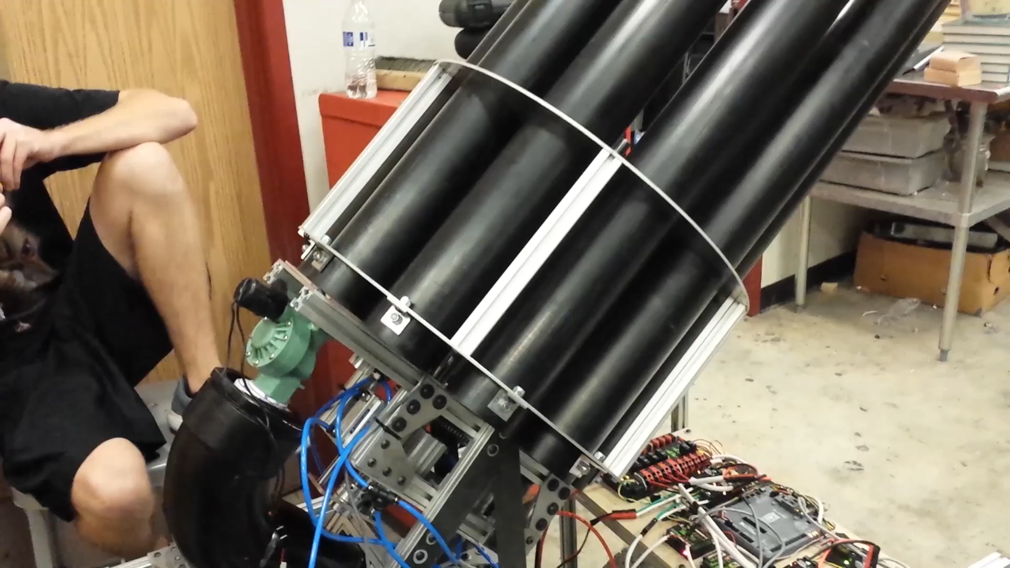
Stealth T-Shirt cannon

Slide 4
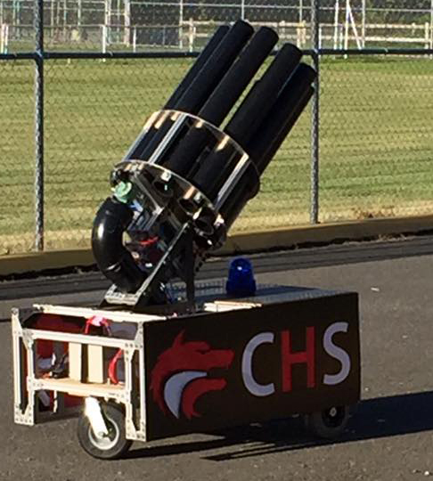
Two Subsystems
Drive Base
Cannon

Slide 5
Drive Base
Four motor base
public static CANTalon driveRightDrive;
public static CANTalon driveLeftDrive;
public static CANTalon driveRightDriveB;
public static CANTalon driveLeftDriveB;
static int kRightMotorA = 1;
static int kRightMotorB = 2;
static int kLeftMotorA = 3;
static int kLeftMotorB = 4;
driveRightDrive = new CANTalon(kRightMotorA);
driveRightDriveB = new CANTalon(kRightMotorB);
LiveWindow.addActuator("Drive", "RightDrive", driveRightDrive);
driveLeftDrive = new CANTalon(kLeftMotorA);
driveLeftDriveB = new CANTalon(kLeftMotorB);
LiveWindow.addActuator("Drive", "LeftDrive", driveLeftDrive);

Slide 6
Drive Base
The second motor is chained to the main one
driveRightDrive.set(0);
driveRightDriveB.changeControlMode(CANTalon.TalonControlMode.Follower);
driveRightDriveB.set(kRightMotorA);
driveLeftDrive.set(0);
driveLeftDriveB.changeControlMode(CANTalon.TalonControlMode.Follower);
driveLeftDriveB.set(kLeftMotorA);
driveRobotDriveMotors = new RobotDrive(driveLeftDrive, driveRightDrive);

Slide 7
Drive subsystem
Drive is simple, it has one method in it ‘Drive’
public void Drive(Joystick driveJoystick) {
double y = driveJoystick.getY();
double z = driveJoystick.getZ();
robotDriveMotors.arcadeDrive(y, z);
}

Slide 8
Cannon
A lot more complex
Barrel goes in one out
Barrel turns
Air chamber fills
Air is released
Warning Light

Slide 9
Cannon Controls
The trigger will shoot a T-Shirt, change barrel, charge tank, and light the blue light
A button will push the barrel out
A button will pull the barrel in
A button will rotate the barrel until the button is released.
A button will shoot
A button will fill the tank

Slide 10
Cannon Subsystem
public void zeroEncoder()
public void initDefaultCommand()
public void startShoot()
public void shoot()
public boolean isShootDone()
public void startBarreling()
public void setBarrelIn()
public void setBarrelOut()
public boolean isBarrleIn()
public boolean isBarrleDone()
public void startCharging()
public void charge()
public boolean isCharged()
public void zeroBarrels()
public void setNextBarrel()
public void rotate()
public boolean isNextBarrel()
public void startRotate()
public void stopRotate()

Slide 11
Commands
AutomatedFire
BarrelsIn
BarrelsOut
ChargeTank
Rotate
RotateUntilLimit
Shoot

Slide 12
Automated fire
automatedFireButton = new JoystickButton(utilityJoystick, 1);
automatedFireButton.whenPressed(new AutomatedFire());
public AutomatedFire() {
addSequential(new Shoot());
addSequential(new BarrelOut());
addSequential(new ChargeTank());
addParrellel(new RotateUntilLimit());
addSequential(new BarrelIn()); }

Slide 13
RotateUntilLimit
public class RotateUntilLimit extends Command {
StopWatch mWatcher = new StopWatch(15000);
public RotateUntilLimit() {
requires(Robot.cannon);
System.out.println("RUL cons");
}
protected void initialize() {
System.out.println("RUL init");
mWatcher.reset();
Robot.cannon.startBarreling();
Robot.cannon.setBarrelOut();
Robot.cannon.setNextBarrel();
}

Slide 14
RotateUntilLimit
// Called repeatedly when this Command is scheduled to run
protected void execute() {
if(true == Robot.cannon.isBarrleDone())
{
Robot.cannon.rotate();
}
}

Slide 15
RotateUntilLimit
protected boolean isFinished() {
boolean gotToNext = (Robot.cannon.currentBarrel == Robot.cannon.nextBarrel);
boolean stopWatchFinished = mWatcher.isExpired();
if((true == stopWatchFinished) || (true == gotToNext))
{
Robot.cannon.stopRotate();
System.out.print("Watch:");
System.out.print(stopWatchFinished);
System.out.print(" Next:");
System.out.println(gotToNext);
return true;
}
return false;
//return Robot.cannon.isLimitPressed();
}

Slide 16
RotateUntilLimit
protected void end() {
System.out.println("RUL end");
Robot.cannon.stopRotate();
Robot.cannon.reachedNextBarrel = false;
}
// Called when another command which requires one or more of the same
// subsystems is scheduled to run
protected void interrupted() {
System.out.println("RUL intr");
end();
}

Slide 17
setBarrelIn
public void setBarrelIn() {
// Check if safe to barrel in
if(true == isSafeToBarrleIn) {
if(true == boolBarrleDebug) {
boolBarrleDebug = false;
System.out.println("Barrel In");
}
isBarrelIn = true;
barrelExtender.set(true);
}
else {
if(true == boolBarrleDebug) {
boolBarrleDebug = false;
System.out.println("Not Safe to Barrel In");
}
isBarrelIn = false;
}}

Slide 18
Robot
public void robotInit() {
RobotMap.init();
drive = new Drive();
cannon = new Cannon();
oi = new OI();
}

Slide 19
Robot
public void teleopInit() {
// This makes sure that the autonomous stops running when
// teleop starts running. If you want the autonomous to
// continue until interrupted by another command, remove
// this line or comment it out.
if (autonomousCommand != null) autonomousCommand.cancel();
}
/**
* This function is called periodically during operator control
*/
public void teleopPeriodic() {
Scheduler.getInstance().run();
}

Slide 20
StopWatch
public class StopWatch
{
long mLastTime = 0;
int mWaitTime = 0;
public StopWatch(int waitTime)
{
mWaitTime = waitTime;
}
public void setTime(int waitTime)
{
mWaitTime = waitTime;
}

Slide 21
StopWatch
public boolean isExpired()
{
if((System.currentTimeMillis()-mLastTime)>mWaitTime)
{
return true;
}
return false;
}
public void reset()
{
mLastTime = System.currentTimeMillis();
}
}

